Slide 1
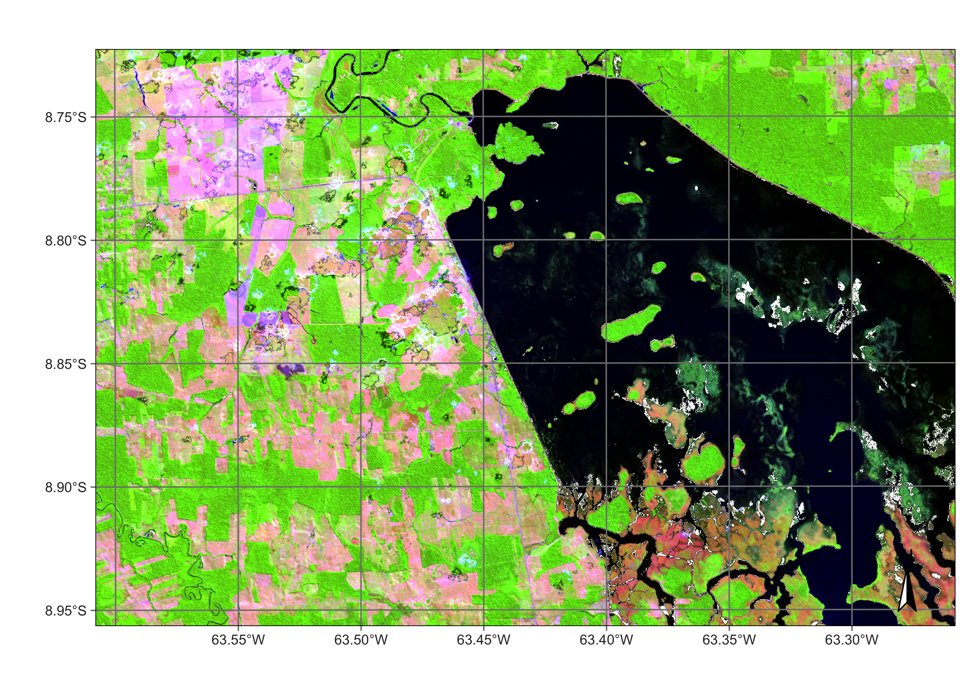
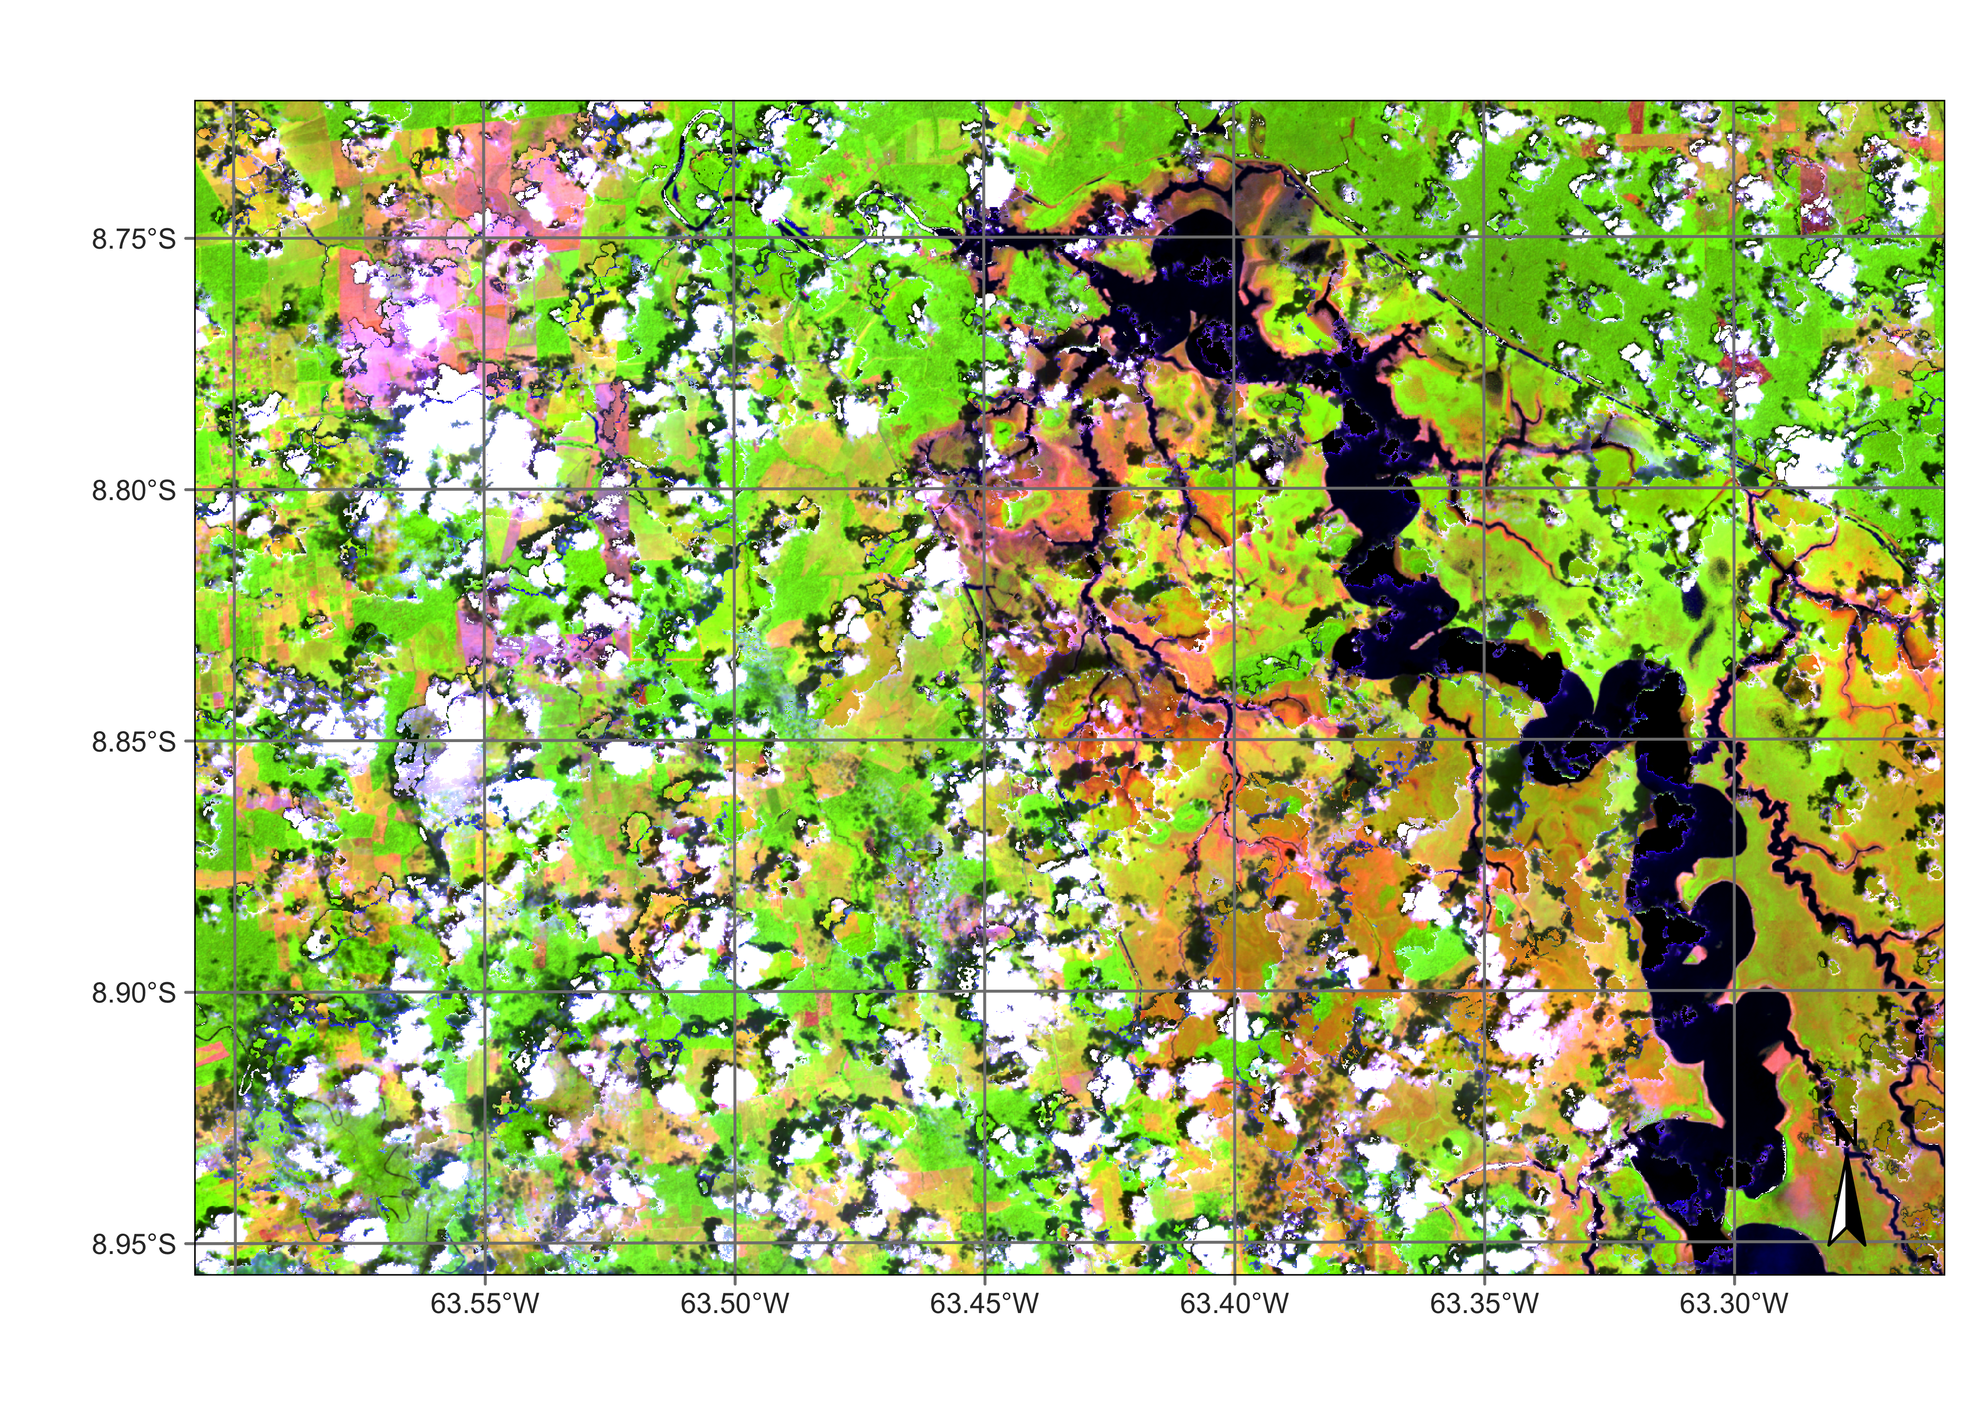
What’s in an image time series?
Searching for changes instead of searching for content. (Camara et al., “What’s in an image?”, COSIT 2001)

Slide 2


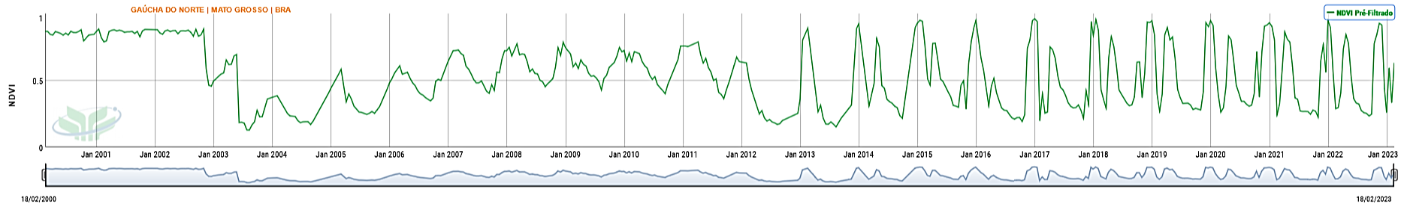
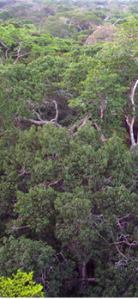

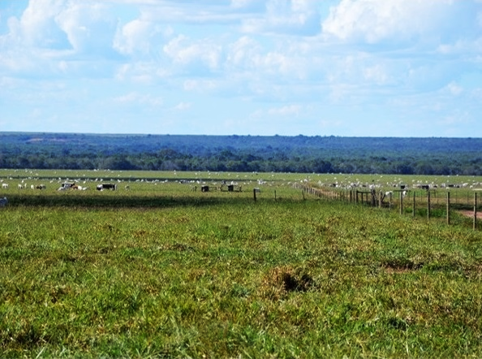
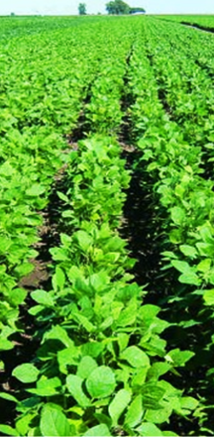
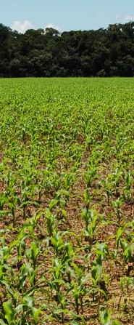
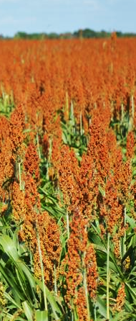


Time Series showing changes
Desmatamento
Floresta
Pastagem
Culturas Agrícolas Temporárias
Embrapa Agricultura Digital
2

Slide 3


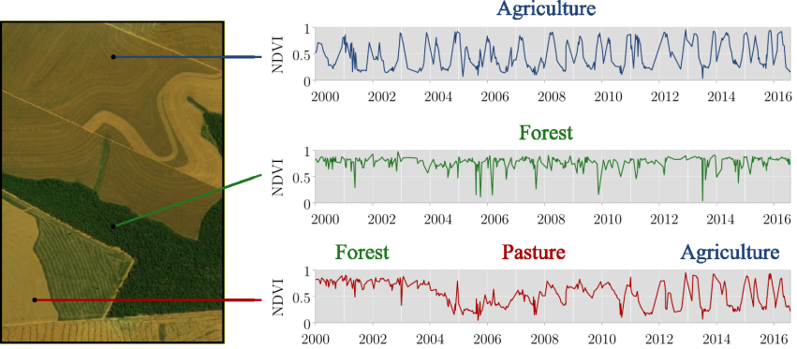
Time series measure change
How to classify land use and land cover using time series?
graphics: Maus, Victor
Notes:
Uma questão que emerge imediatamente como consequência dessa escolha é:
“Como classificar cobertura e uso da Terra usando séries temporais?”
Aqui nessa imagem, nós podemos ver séries temporais de NDVI do sensor MODIS de diferentes localizações entre os anos 2000 e 2016.
Na primeira, constatamos uma série típica de agricultura. Na segunda, uma série típica de cobertura florestal. Na terceira, observamos uma trajetória de mudanças, começando com floresta, depois pastagem e, na sequência, agricultura.

Slide 4
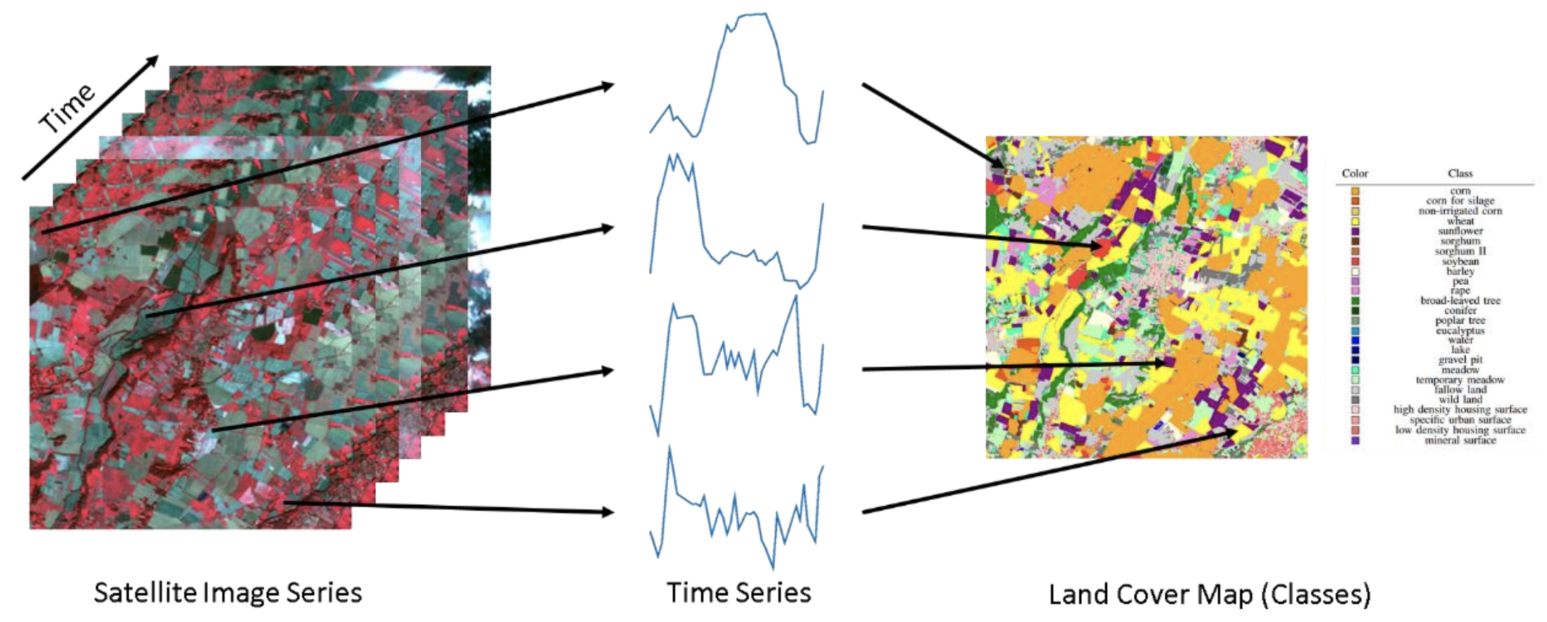
Land classification with image time series
image: F Petitjean, Monash Univ
Notes:
Sits is an R package for Satellite Image Time Series Analysis for Earth Observation Data Cubes.
This package provides a simples API for a complete and complex workflow for land classification from big EO data sets.
It provides funcionalities to:
Create and define earth observation data cubes
Assess and improve land use and cover samples using neural network and Self-Organizing maps (SOM)
Train different kinds of machine learning methods using land use and cover samples
Classify the data cube using the trained model.
Perform some kind of post-processing (such as smoothing) to generate the final map.
Spatial smoothing methods remove outliers from the classification.

Slide 5
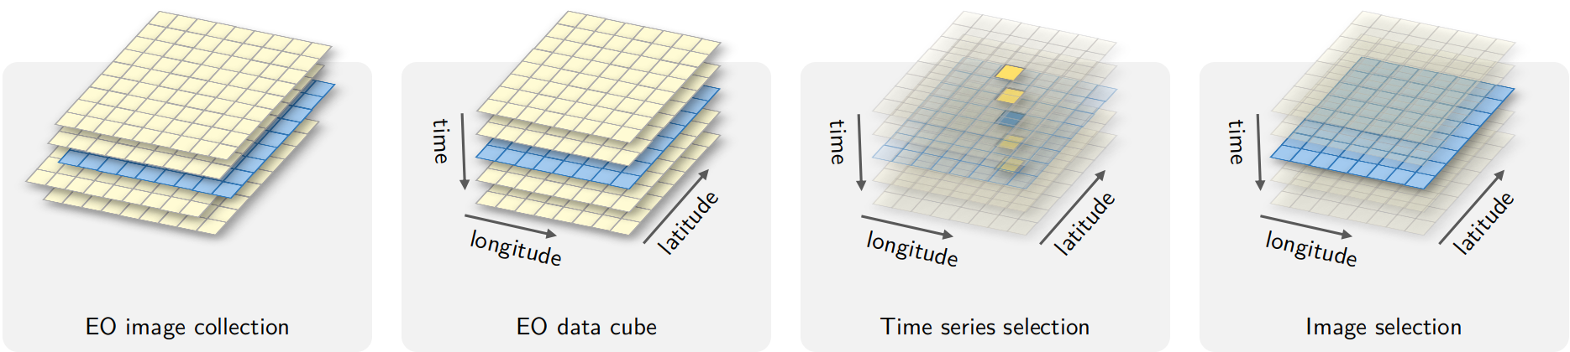
What is an EO data cube?
Data cube = regular partitions of space and time

Slide 6
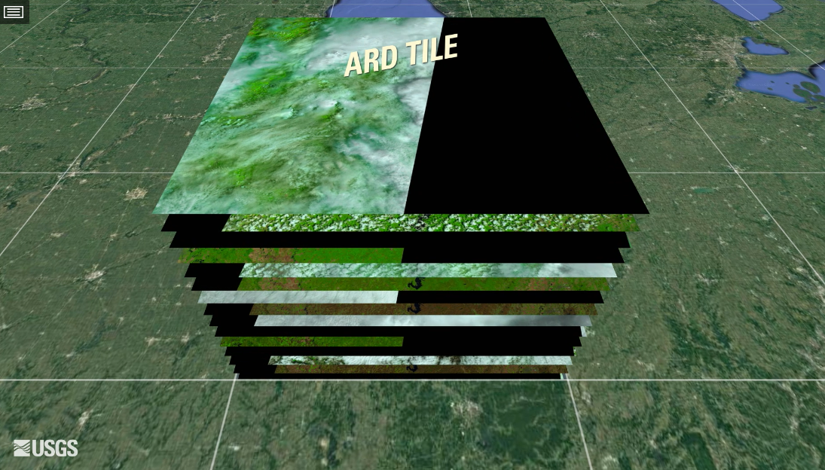
What is an ARD image collection?
Image collections are not regular in space and time.
Bands may have different resolutions.
Temporal intervals may be irregular.

Slide 7
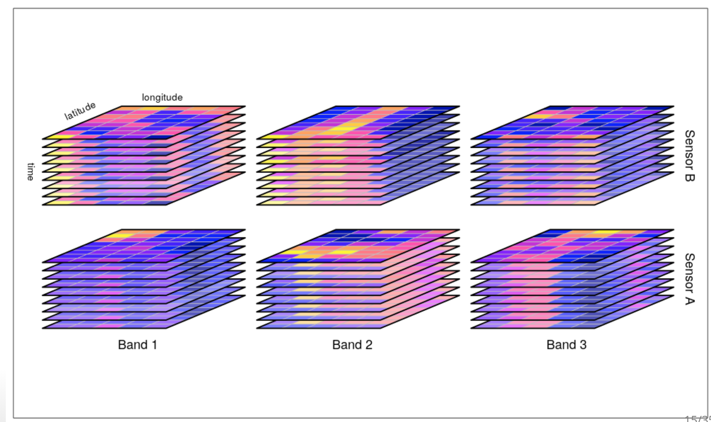
What is an ARD image collection?
An image collection is a set of 2D images, where each image contains spectral bands. All bands from one image share a common spatial footprint, acquisition date/time, and spatial reference system. Images in a collection may have different pixel sizes.
source: Appel and Pebesma (2018)

Slide 8

What is an EO data cube?
Data cube = regular partitions of space and time

Slide 9
What is a data cube?
A regular, dense raster data cube is a four-dimensional array with dimensions x (longitude or easting), y (latitude or northing), time, and bands with the following properties:
Spatial dimensions refer to a spatial reference system (SRS);
Cells of a data cube have a constant spatial size;
The cube axes are aligned with the SRS axes;
The temporal reference is a known set of temporal intervals;
For every combination of dimensions, a cell has a single (real) attribute value.
adapted from Appel and Pebesma (2018)

Slide 10
How to analyze image time series?
CCDC, BFAST, TimeSat
Parametric
Atemporal: RF, MLP, XGBoost
Data-driven
Time-sensitive: TempCNN, LightTAE

Slide 11
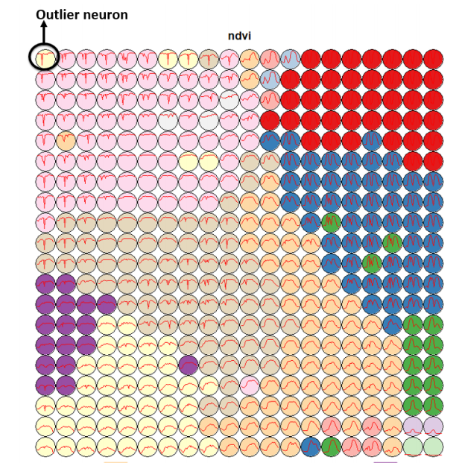
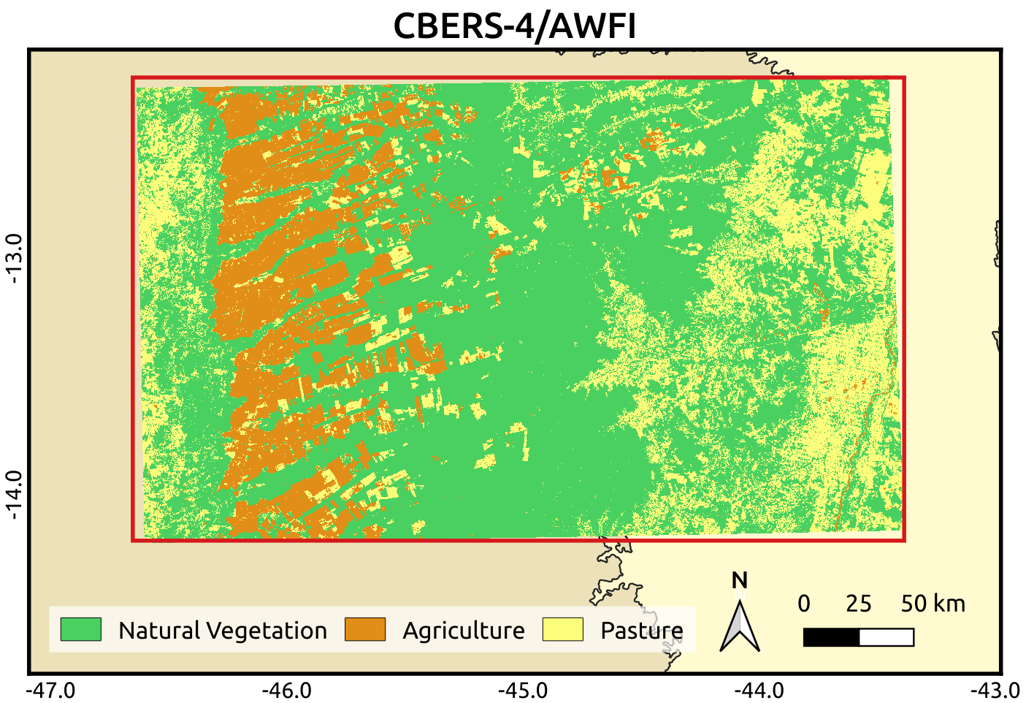
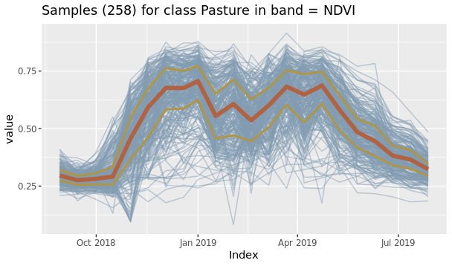
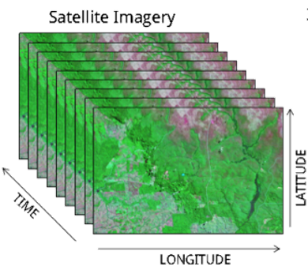

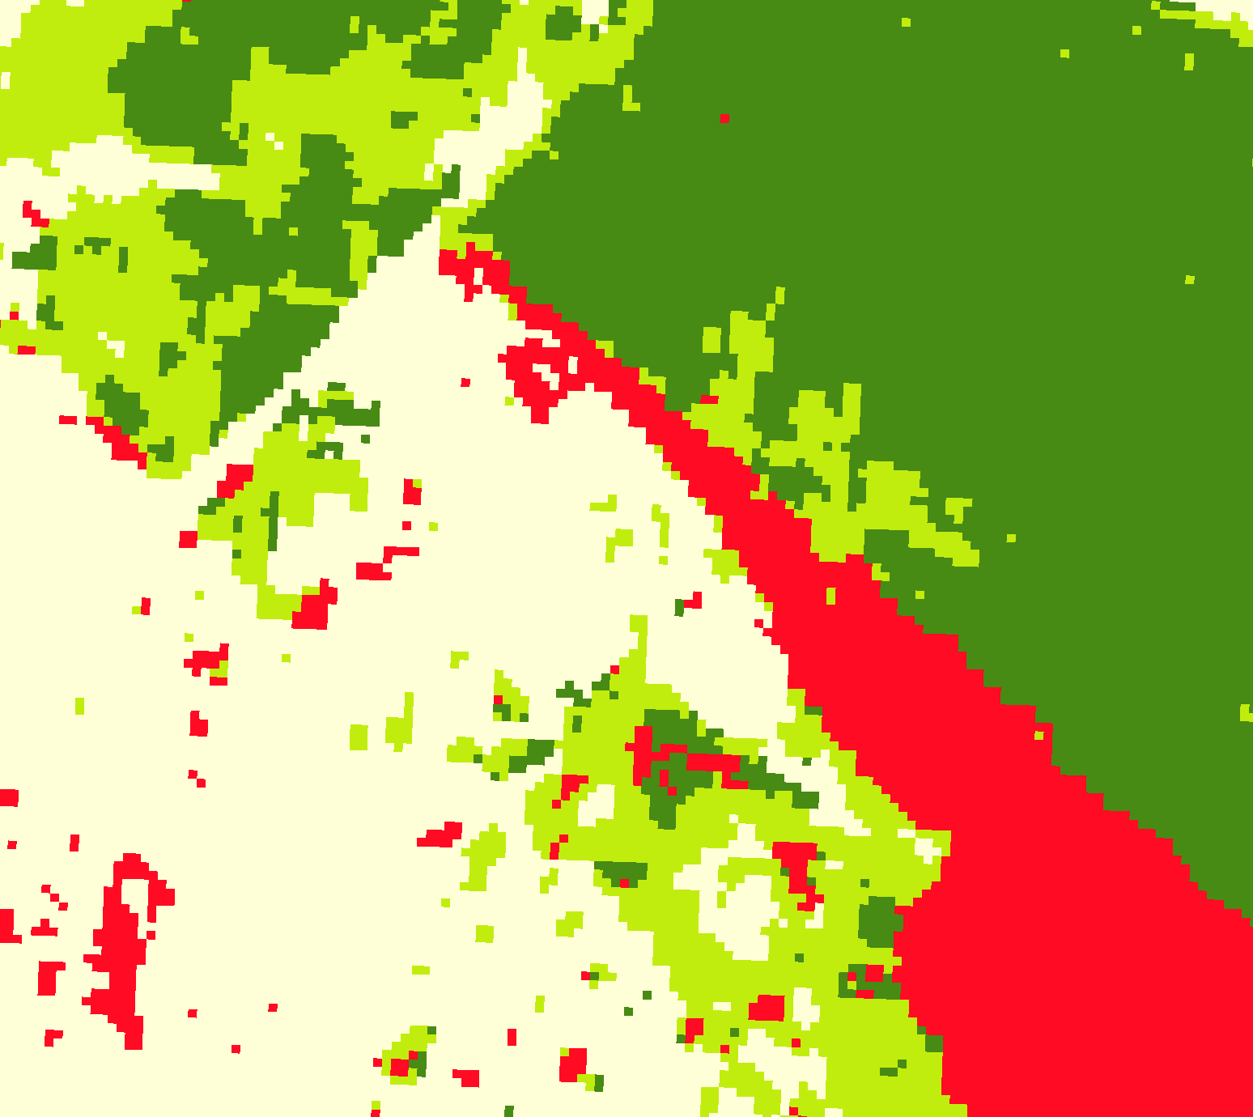
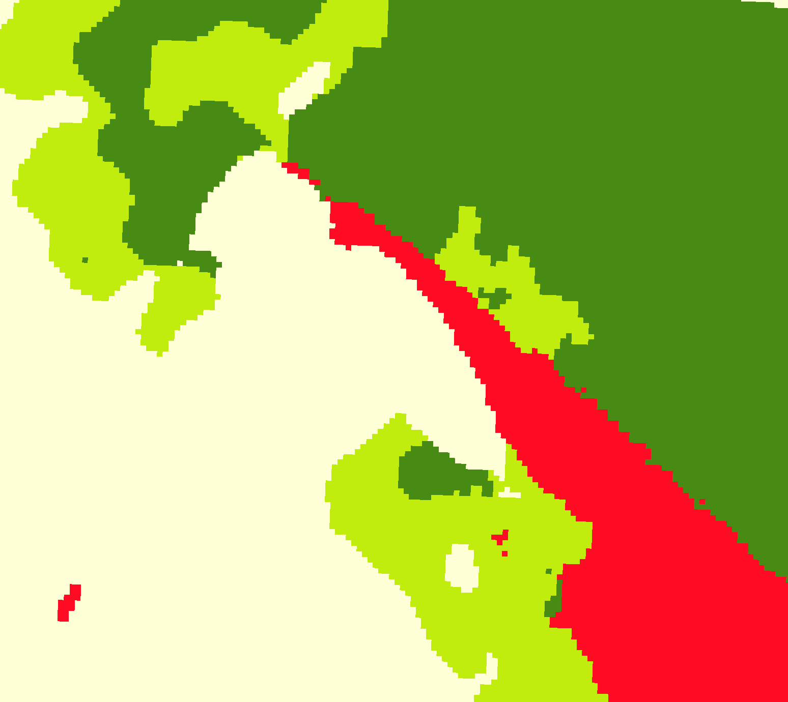
Complete land classification workflow
LUCC samples
Quality Analysis
LUCC maps
EO data cubes
ML models
Classification and smoothing
Notes:
Sits is an R package for Satellite Image Time Series Analysis for Earth Observation Data Cubes.
This package provides a simples API for a complete and complex workflow for land classification from big EO data sets.
It provides funcionalities to:
Create and define earth observation data cubes
Assess and improve land use and cover samples using neural network and Self-Organizing maps (SOM)
Train different kinds of machine learning methods using land use and cover samples
Classify the data cube using the trained model.
Perform some kind of post-processing (such as smoothing) to generate the final map.
Spatial smoothing methods remove outliers from the classification.

Slide 12
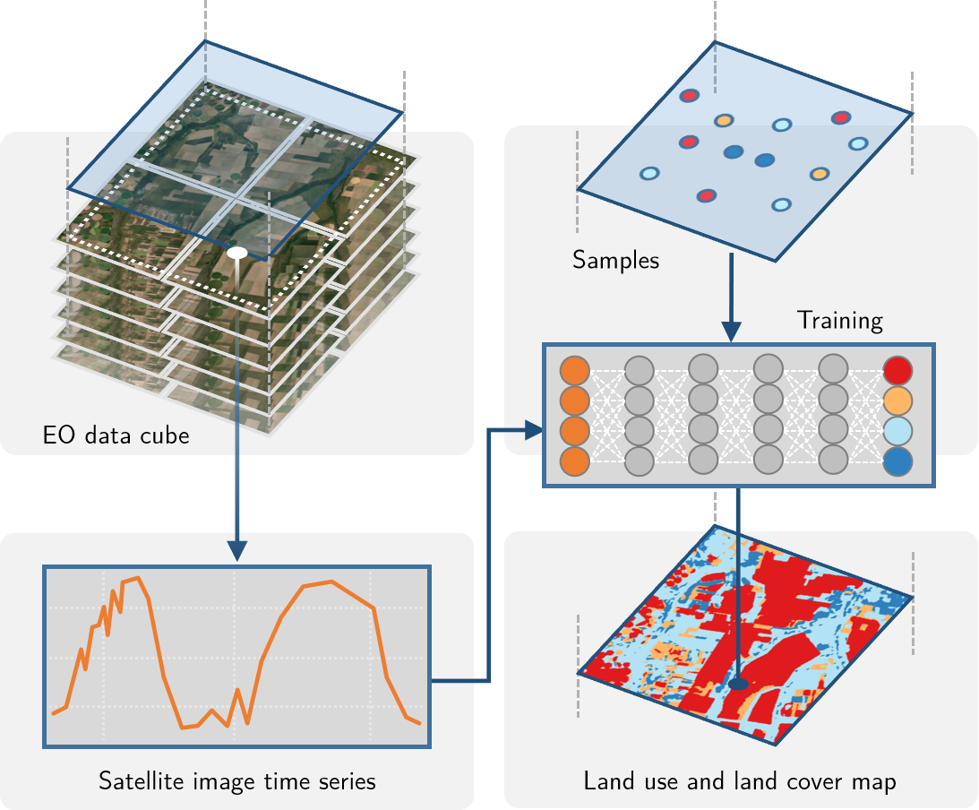
SITS workflow
Notes:
Uma das formas de classificar uma série temporal é passando os dados da série temporal diretamente para algoritmos de aprendizado de máquina.
Primeiramente, as séries temporais devem vir de algum lugar. Conceptualmente, as séries temporais vem de cubos de dados de observação da Terra, que são imagens organizadas que representam as dimensões espaciais (x e y) e a temporal.
Usando amostras que indicam um intervalo de datas e uma localização espacial associados a uma classe de uso e cobertura da Terra, podemos treinar modelos de aprendizado de máquina para gerar mapas de uso e cobertura.

Slide 13

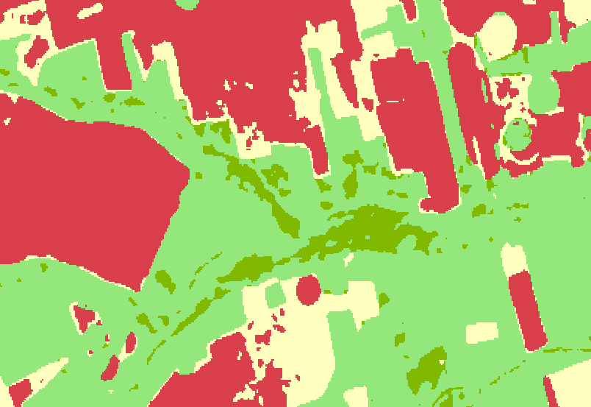

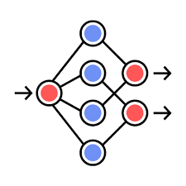
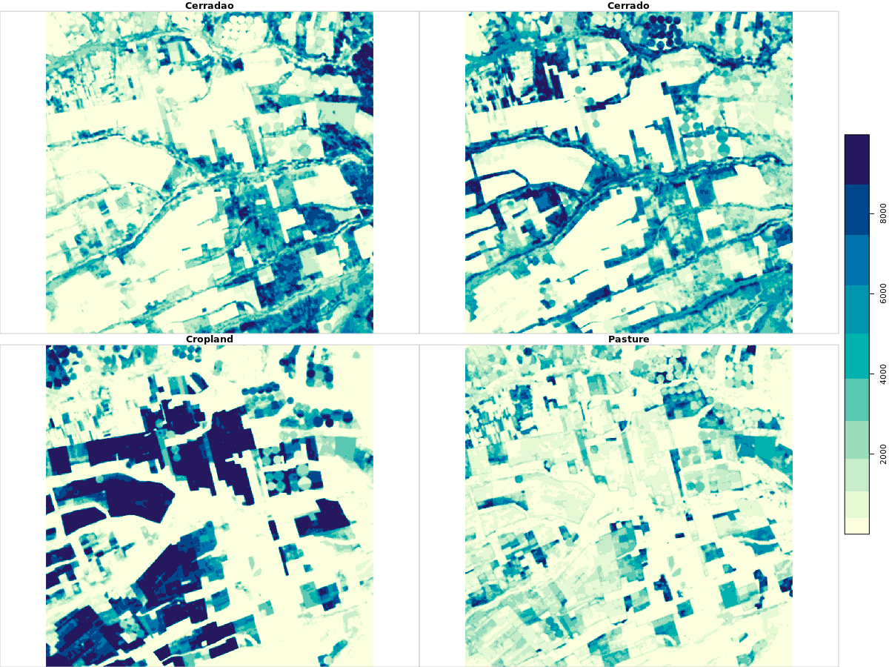
ARD image
collections
Ground truth
sits_cube()
sits_label_classification()
samples
sits_get_data()
cube
sits_classify()
probs
cube
sits_regularize()
sits_smooth()
sits_train()
model
ML algorithm
Notes:
O sits fornece uma API simples e intuitiva que realiza essas tarefas. A API se integra com o fluxo de trabalho apresentado anteriormente.
Aqui, podemos ver que seis comandos são necessários para realizar uma classificação. As funções possuem parâmetros default capazes de fornecer bons resultados, o que facilita a obtenção de bons mapas por usuários novos.
Toda a API foi extensamente documentada.

Slide 14
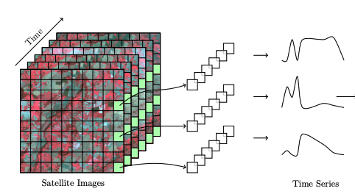
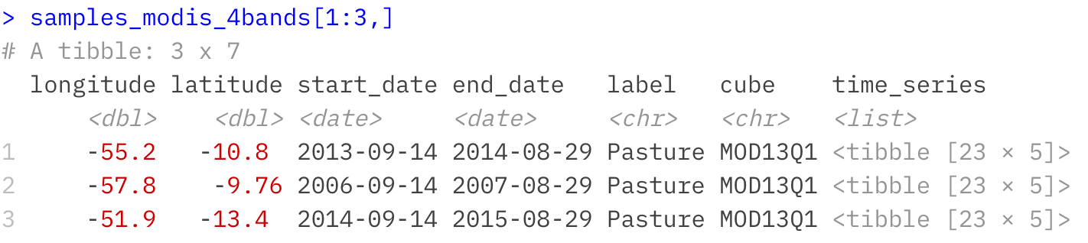
Image time series samples as R objects
Notes:
Sits provides data structures to represent in R EO data cube and image time series.

Slide 15
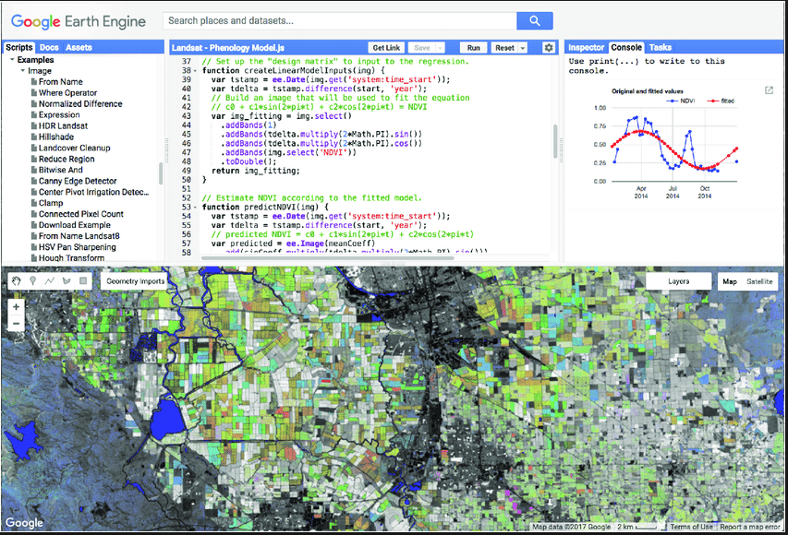
GEE: functional programming paradigm
// select an image collection
var col_l8 = ee.ImageCollection('LANDSAT/LC08/C01/T1_TOA’);
// get a data cube (called “Image” in GEE)
var landsat2016 = l8.filterDate('2016-01-01', '2016-12-31’);
// Compute the Normalized Difference Vegetation Index (NDVI). var nir = image.select('B5'); var red = image.select('B4'); var ndvi = nir.subtract(red).divide(nir.add(red)).rename('NDVI');

Slide 16
SITS equivalent to Google Earth Engine
// select an image collection
l8_cube = sits_cube(source = 'MSPC',
collection = 'LANDSAT-8-C2-L2',
tiles = '232067',
start_date = '2016-01-01’,
end_date = '2016-12-31’)
// get a regularized data cube
l8_cube_reg = sits_regularize(l8_cube, period = “P16D”, res = 30)
// Compute the Normalized Difference Vegetation Index (NDVI). l8_cube_reg = sits_apply(l8_cube_reg, NDVI = (B05 – B04)/(B05 + B04))

Slide 17






Accessing data cubes with STAC
Digital Earth Africa
Brazil Data Cube
Earth on AWS
SEPAL
AI for Earth
Notes:
O sits é baseado em tecnologias Web para ter acesso às coleções de imagens. O uso do protocolo STAC, do qual falaremos um pouco mais no último capítulo, facilita a interoperabilidade entre diferentes repositórios de dados e plataformas de computação em nuvem.
Atualmente o sits fornece suporte aos dados do Sentinel, Landsat, CBERS e MODIS no projeto BDC, Sentinel-2 e Lansat do repositório Digital Earth Africa na AWS e do Sentinel-2 da AWS.
Estamos desenvolvendo o suporte para os repositórios da AI for Earth da Microsoft e o ambiente de cloud da SEPAL.

Slide 18
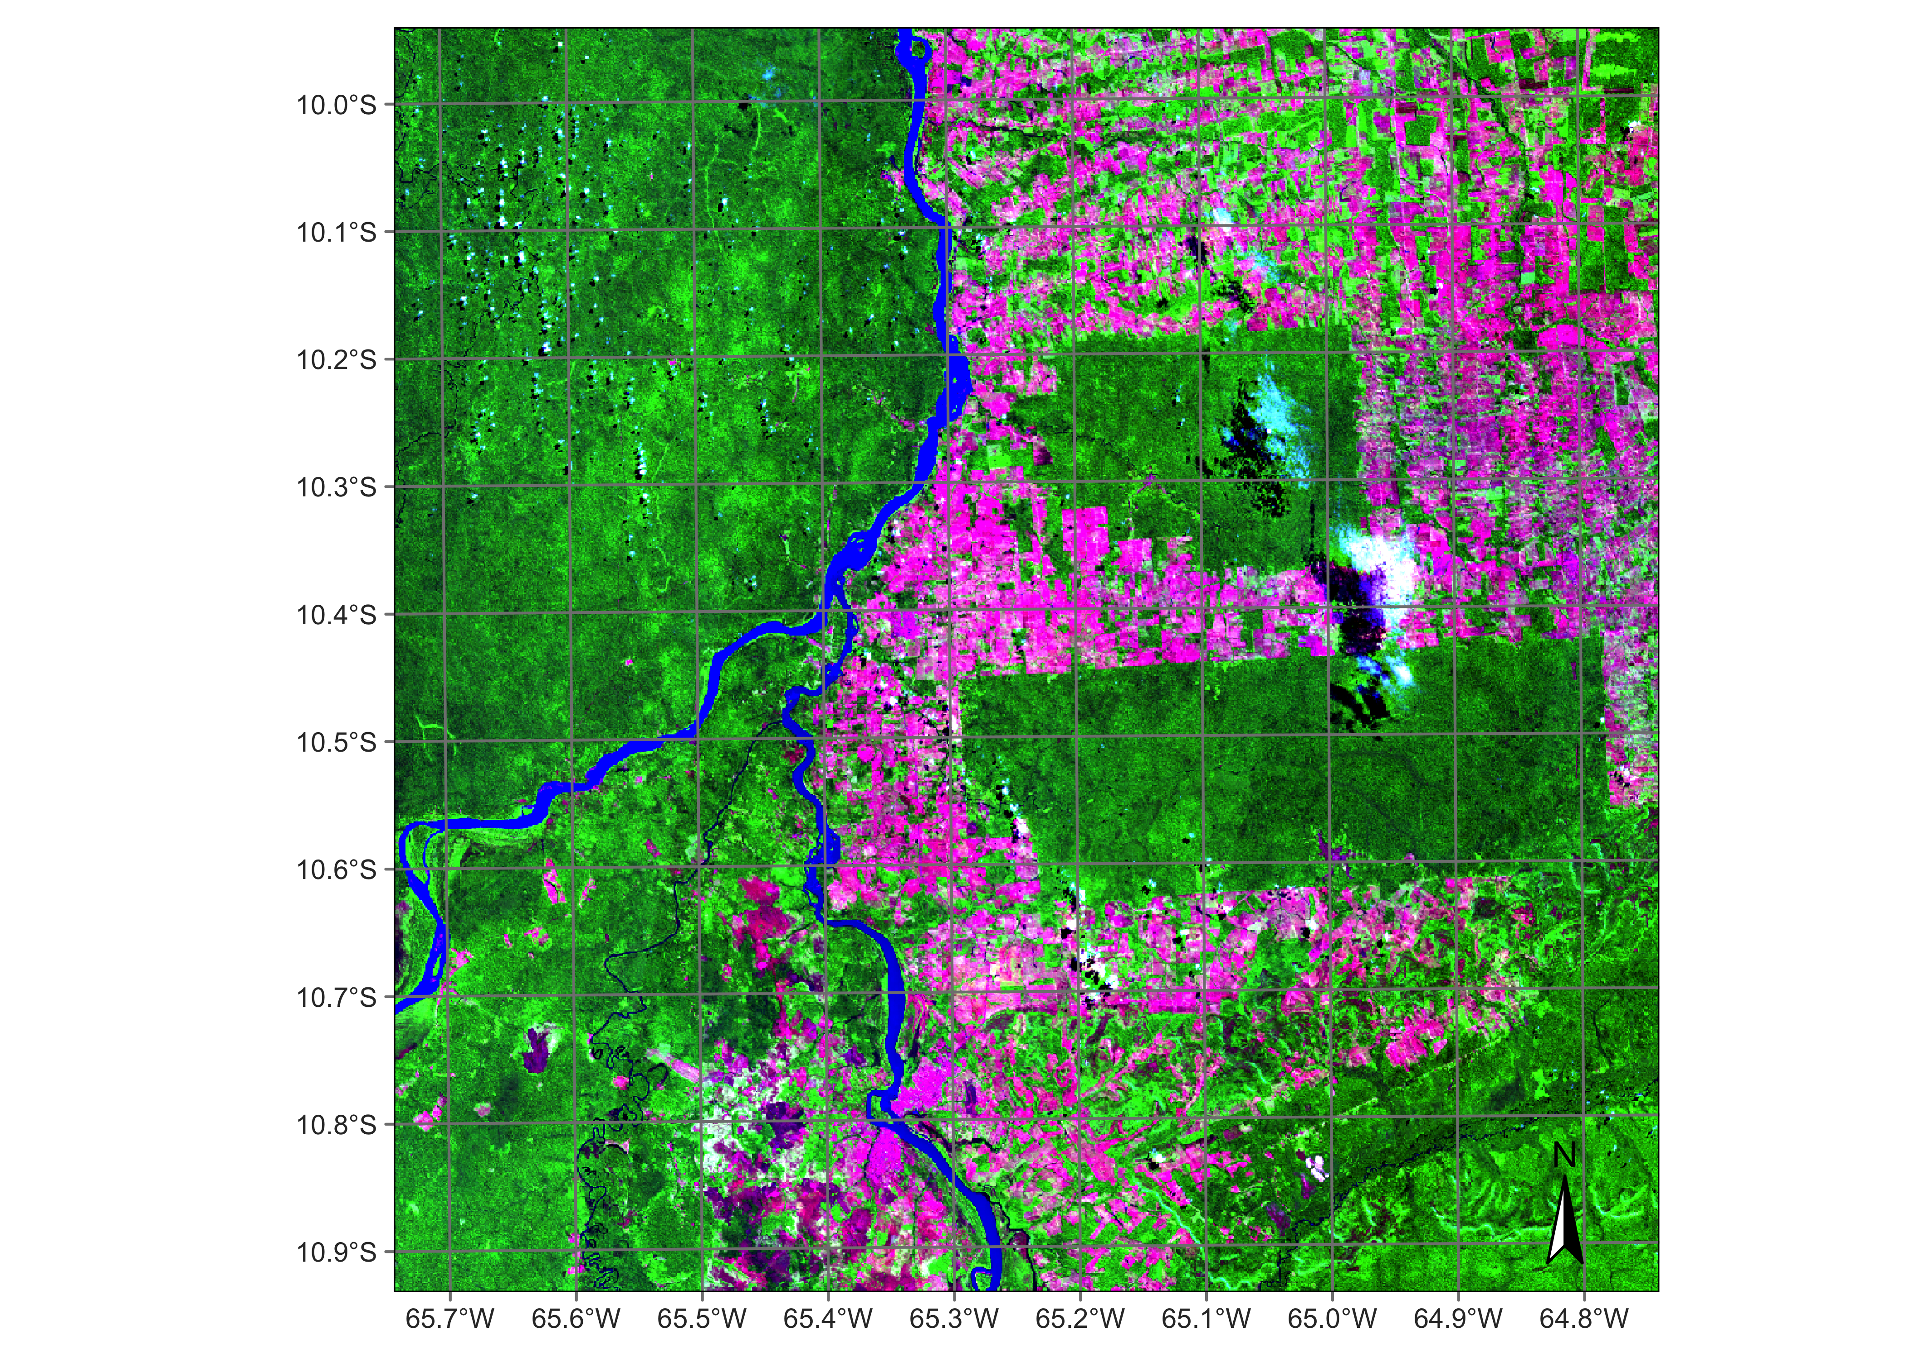
Processing data in MPC
# create a data cube covering an area in the Brazilian Amazon
s2_20LKP_cube_MPC <- sits_cube(
source = "MPC",
collection = "SENTINEL-2-L2A",
tiles = "20LKP",
bands = c("B02", "B8A", "B11", "CLOUD"),
start_date = "2019-07-01",
end_date = "2019-07-28"
)
# plot a color composite of one date of the cube
plot(s2_20LKP_cube_MPC, red = "B11", blue = "B02", green = "B8A", date = "2019-07-18")

Slide 19
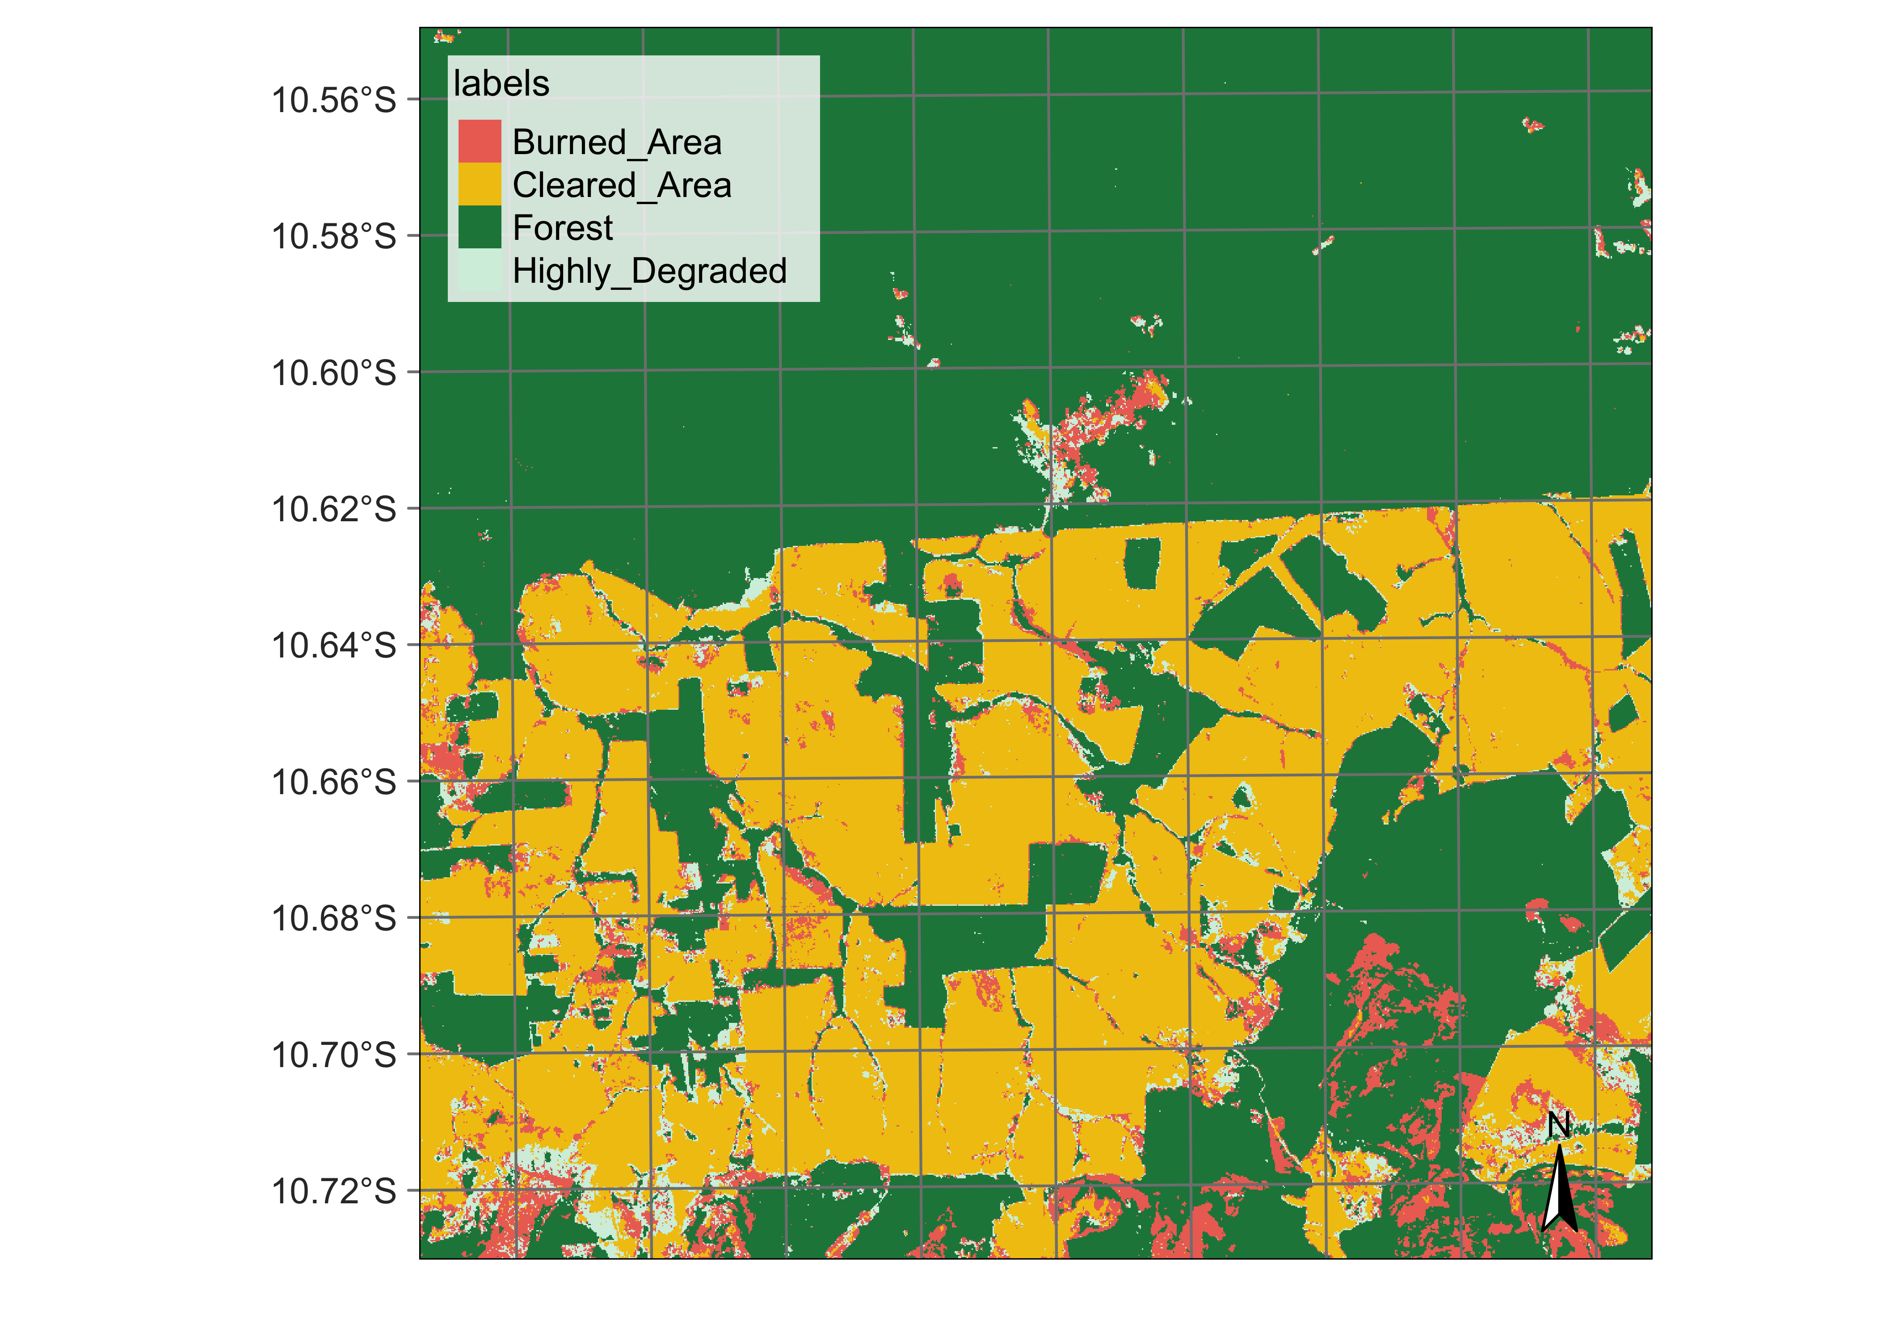
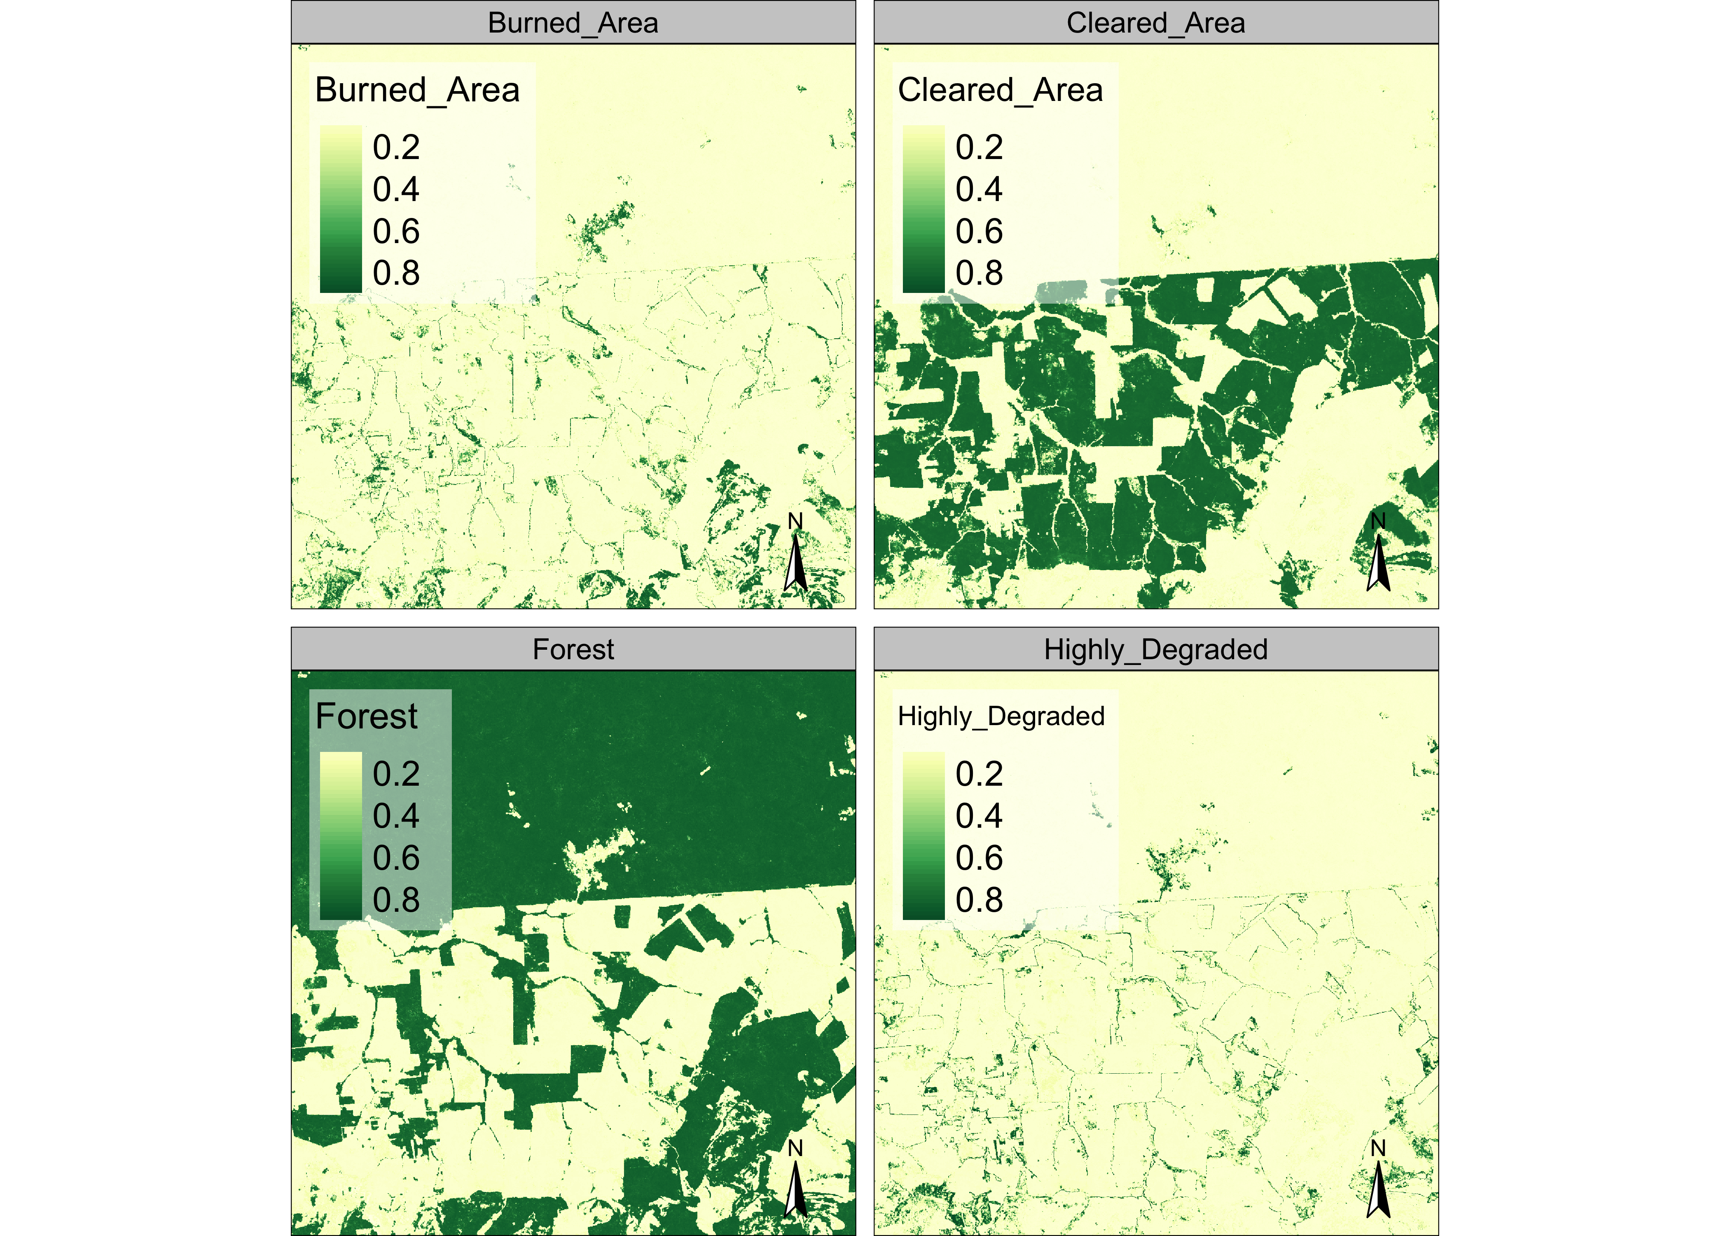
Processing data in MPC
# classify data cube
ro_cube_20LKP_probs <- sits_classify
(data = ro_cube_20LKP,
ml_model = ltae_model)
plot(ro_cube_20LKP_probs
# generate thematic map
defor_map <- sits_label_classification
(cube = ro_cube_20LKP_probs)
plot(defor_map)

Slide 20
Are our samples good?
Alves et al., “Quality control and class noise reduction of satellite image time series”, ISPRS Journal of Photogrammetry and Remote Sensing, vol. 177, pp 75-88, 2021

Slide 21
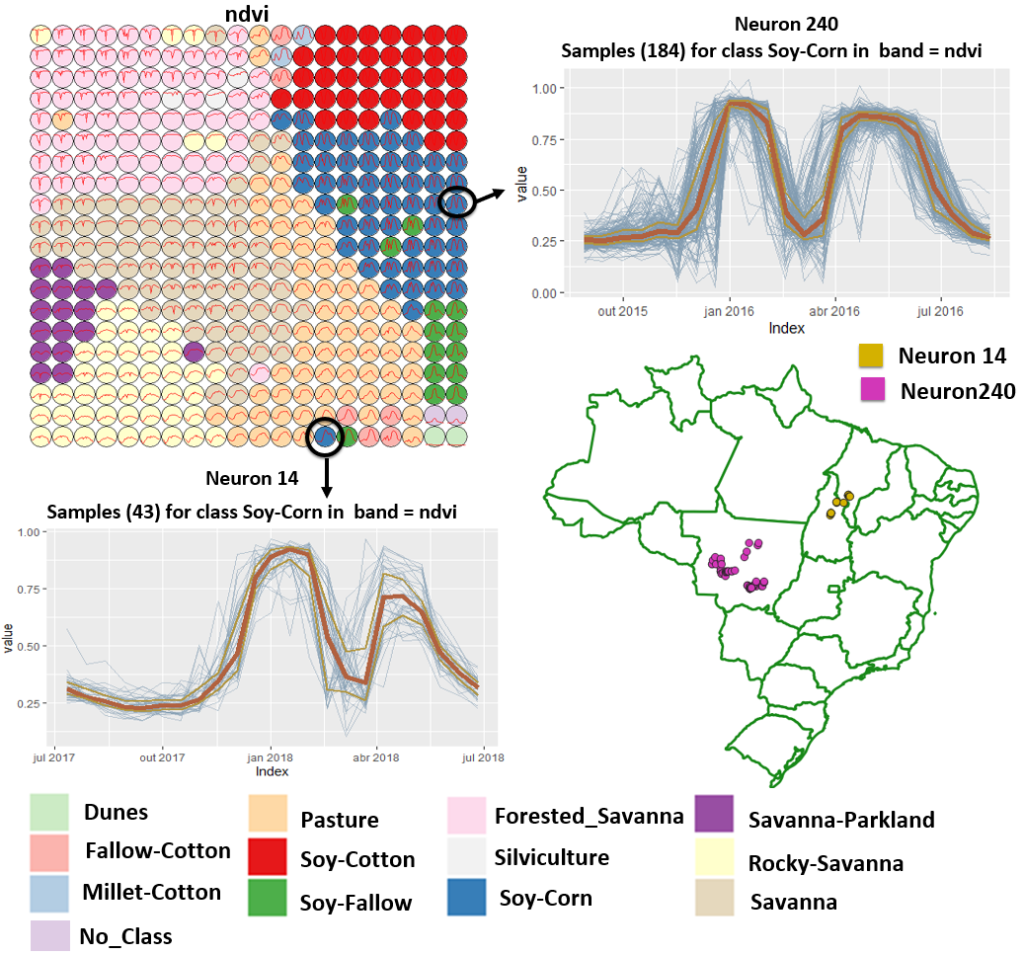
Using SOM to assess sample quality
Alves et al., “Quality control and class noise reduction of satellite image time series”, ISPRS Journal of Photogrammetry and Remote Sensing, vol. 177, pp 75-88, 2021

Slide 22
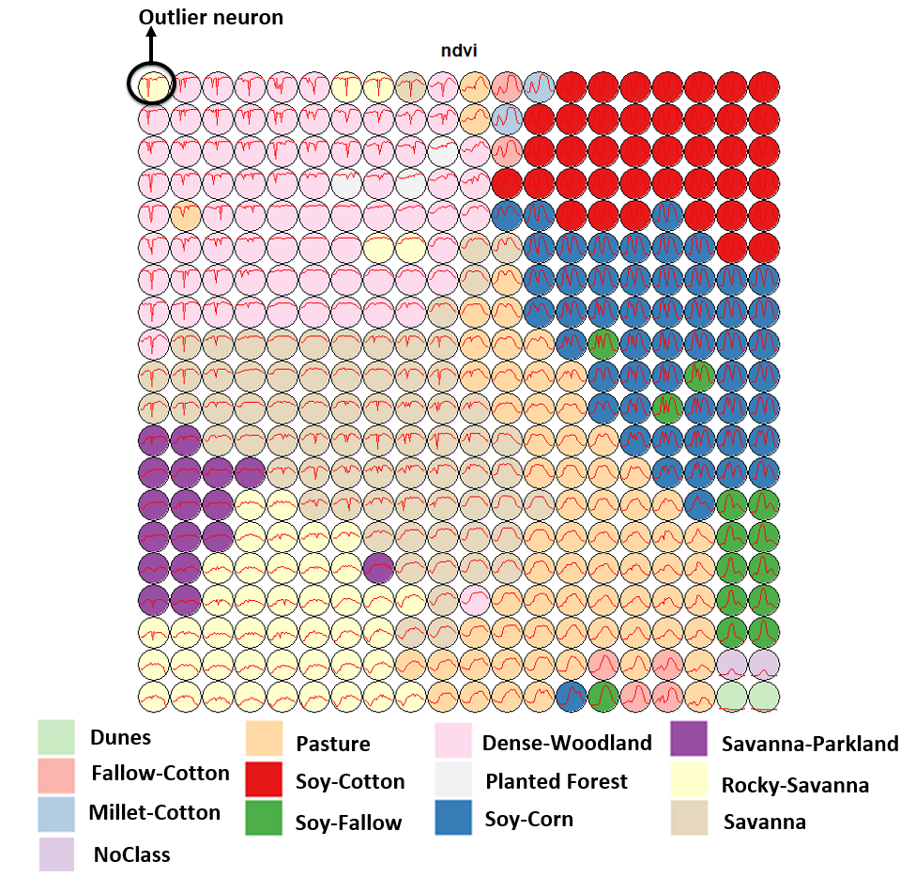
Using SOM to assess sample quality
Alves et al., “Quality control and class noise reduction of satellite image time series”, ISPRS Journal of Photogrammetry and Remote Sensing, vol. 177, pp 75-88, 2021

Slide 23
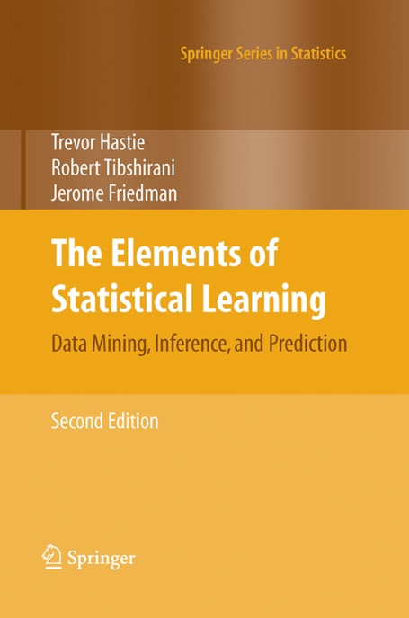
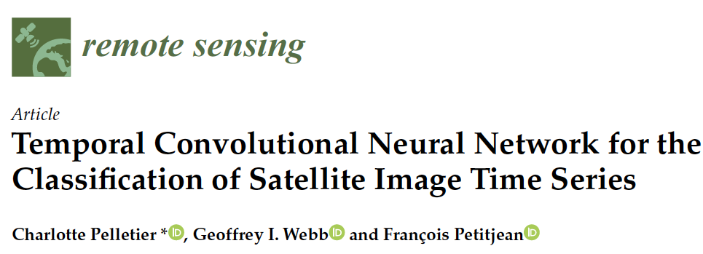
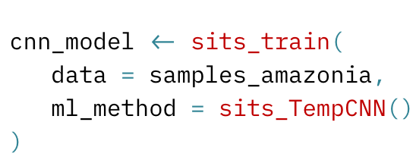

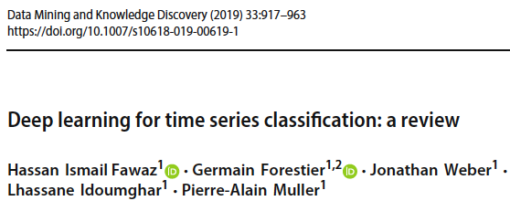
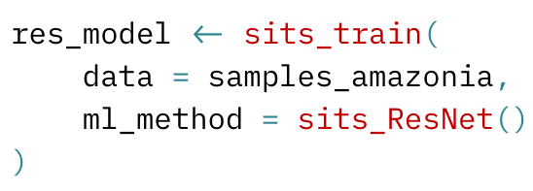
Machine learning and deep learning methods
Notes:
Sits supports different kinds of machine learningand deep learning methods methods, such as random forests, support vector machines, multi-layer perceptrons, temporal convolution neural networks (TempCNN) and InceptionTime described in these research papers and
The user defines the method and its specific parameteres in the sits function “sitis_train” (as you can see here).
========
The first group of methods does not explicitly consider spatial or temporal dimensions;
these models treat time series as a vector in a high-dimensional feature space.
From this class of models, sits includes random forests, support vector machines,
extreme gradient boosting, and multi-layer perceptrons.
The second group of models comprises deep learning methods designed to work
with image time series. Temporal relations between observed values in a time series
are taken into account. Time series classification models for satellite data include 1D
convolution neural networks (1D-CNN), recurrent neural networks (RNN),
and attention-based deep learning. The sits package supports a set of 1D-CNN
algorithms: TempCNN, ResNet, and InceptionTime.
Since sits is aimed at remote sensing users who are not machine learning experts,
the package provides a set of default values for all classification models. These settings
have been chosen based on extensive testing by the authors. Nevertheless, users can
control all parameters for each model. The package documentation describes in detail
the tuning parameters for all models which are available in the respective functions.

Slide 24
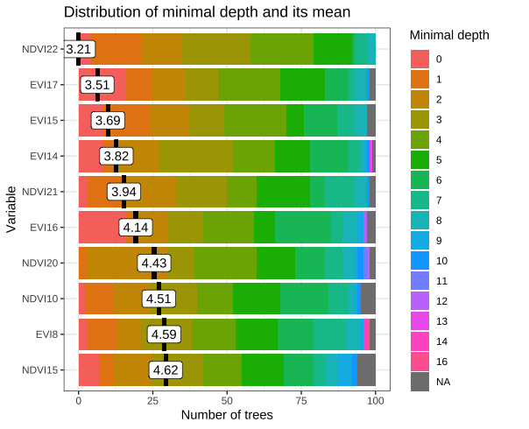

Random forest method for time series analysis

Slide 25
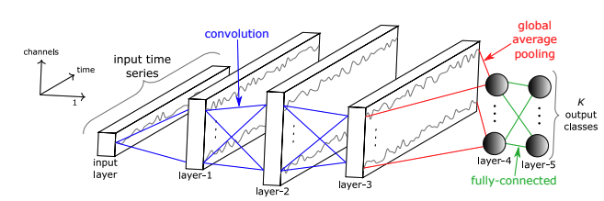
Temporal Convolutional Neural Network for remote sensing time series classification
TempCNN measures short-term and long-term relations in time series

Slide 26
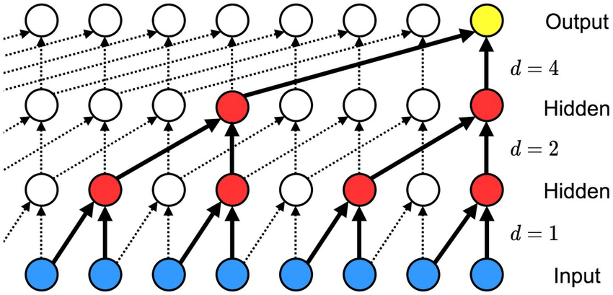
TempCNN for remote sensing time series classification
Each hidden layer captures different relations between elements of the time series

Slide 27
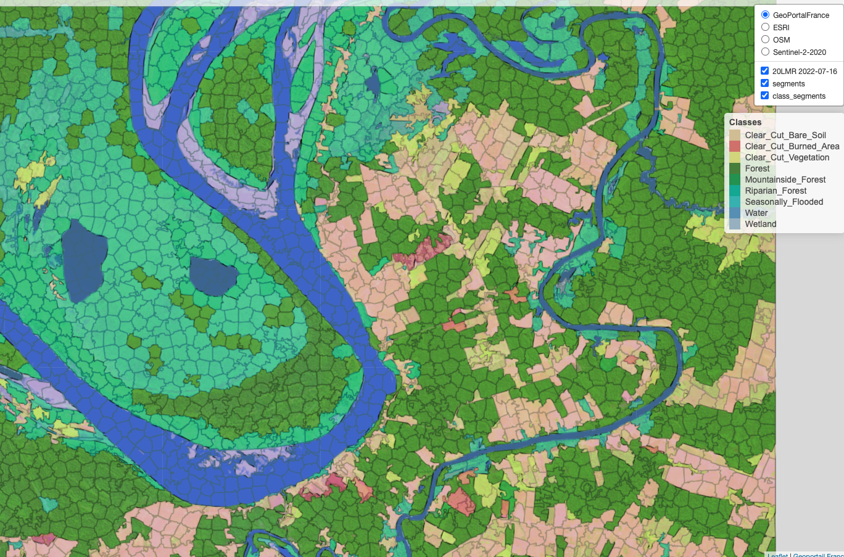
Object-based image time series analysis

Slide 28
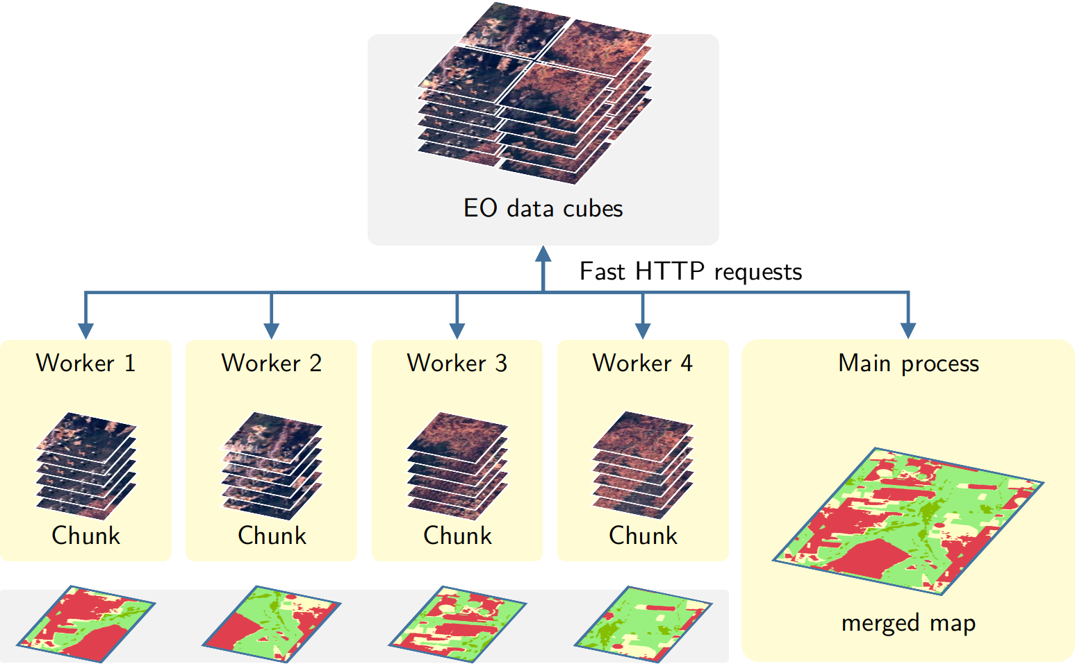
Transparent and efficient parallel processing
Notes:
Image classification in sits is done in parallel.
Sits divides data cubes into chunks and processes them in parallel, based on the number of cores and available memory
defined by the user in the funtion “sits_classify”.
========
, by a cluster of independent workers linked to one or more virtual machines.
The best trade-off has to be determined by the user, considering issues such disk read speed, number of cores in the server, and CPU performance. The memsize parameter controls the size of the main memory (in GBytes) to be used for classification. A practical approach is to set memsize to about 30% of the total memory available.

Slide 29
Bayesian smoothing for post-processing
x_{i}
Neighbourhood: S_{i} and m_{i}
A layer for each label
x_{i}
x_{i}
x_{i}
x_{i}
∑_{i} is provided by user

Slide 30

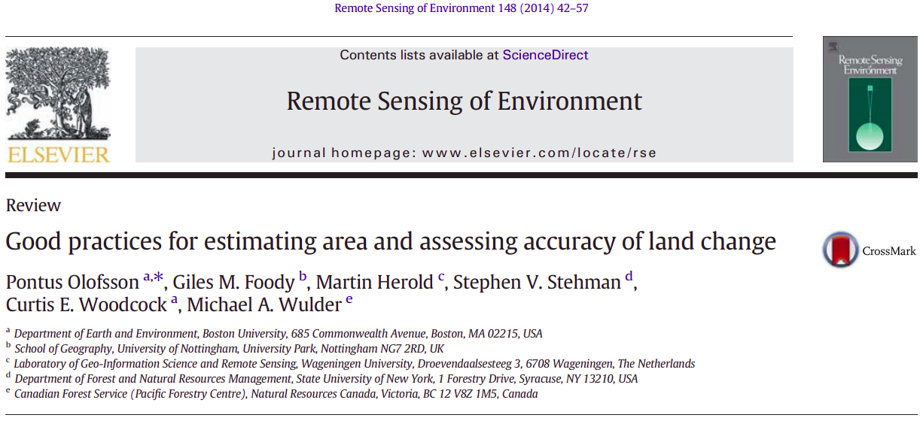
Accuracy assessment supports best practices

Slide 31
Demonstration
https://github.com/e-sensing/sits
https://e-sensing.github.io/sitsbook/

